Slide 1
A Presentation on the Study of Psychosocial Treatments for Cocaine Dependence
By ECHEFU chinwendu

Slide 2
Background
The data used for this study was obtained from a multicenter investigation by the National Institute on Drug Abuse Collaborative Cocaine treatment Study.
This study examines the efficacy of four psychosocial treatments for cocaine dependent patients in determining their Addiction Recovery Scale score.
Data used for the analysis was reduced to consist of the active phase of treatments (month 1 through month 6).
The Addiction Recovery Scale is a 40-item measure that was used in the study to evaluate mediators of outcome in drug counseling. The scale ranges from 1 to 5 with total scores from 40 to 200.
Higher scores indicate more endorsement of the philosophy and behaviors advocated in the 12-step programs.

Slide 3
Data
5 variables were used in this study
Outcome – Addiction Recovery Score
Treatments – 4 treatments include: IDC (Individual Drug Counselling), CT (Cognitive therapy), SE (Supportive Expressive therapy) and GDC (Group Drug Counselling).
Race - 2 categories: 1 – Caucasians; 0 – Non Caucasians.
Gender - 2 categories: 1 – female; 0 – male
Job - 2 categories: 1 – Employed; 0 – Unemployed
350 patients had data for month 3 while 387 had data for month 6
Patients were randomly assigned to treatment from the coordinating center.
Cross-sectional Analysis at Month 3 and Month 6 was carried out.

Slide 4
Models
One-way, two-way and three-way analysis of variance approach (using PROC GLM in SAS) were used.
A cross-sectional analysis was carried out at 3 and 6 months.
For the one-way analysis of variance (ANOVA), the efficacy of the 4 treatment groups were assessed in determining the Addiction Recovery Scale
Race and Gender were used in the 2-way ANOVA while Race, Gender and Job were used in the 3-way ANOVA in determining the Addiction Recovery Scale.
At the end of the analysis, findings from the cross-sectional analysis at 3 and 6 months were compared.

Slide 5
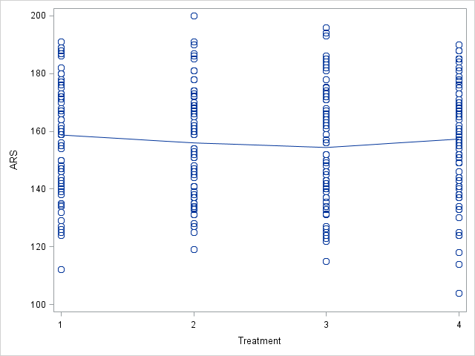
Month 3 One-Way ANOVA - treatment
Source | DF | Sum of Squares | Mean Square | F Value | Pr > F
Model | 3 | 726.2168 | 242.0723 | 0.64 | 0.5900
Error | 290 | 109749.6380 | 378.4470
Corrected Total | 293 | 110475.8548
Based on the available data, there is no evidence to indicate that at least one of the groups of treatment is significantly useful in determining the Addiction Recovery Score of cocaine dependent patients.
TX_COND | ARS LSMEAN | 95% Confidence Limits
1 | 158.618357 | 154.008979 | 163.227736
2 | 155.889813 | 151.438880 | 160.340746
3 | 154.283135 | 149.739141 | 158.827128
4 | 157.208013 | 152.927243 | 161.488783
No evidence of a violation of homogeneity of variance, p-value = .8526
Independence assumption met, p-value = .3342
Attempted to normalize the data, unfortunately, BoxCox was not able to yield normalized residuals, therefore the results should be interpreted with caution.

Slide 6
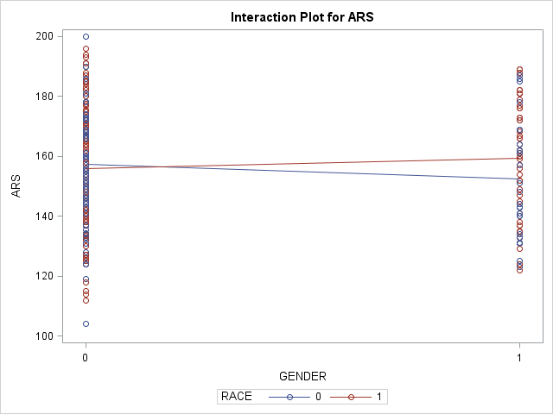
Month 3 2-way ANOVA – gender and race
Source | DF | Sum of Squares | Mean Square | F Value | Pr > F
Model | 3 | 962.9085 | 320.9695 | 0.85 | 0.4676
Error | 290 | 109512.9463 | 377.6308
Corrected Total | 293 | 110475.8548
Based on the available data, there is no evidence to indicate that at least one of the terms in the model is significantly useful in determining the Addiction Recovery Score of cocaine dependent patients.
Source | DF | Type III SS | Mean Square | F Value | Pr > F
GENDER | 1 | 19.9859393 | 19.9859393 | 0.05 | 0.8182
RACE | 1 | 376.0837276 | 376.0837276 | 1.00 | 0.3191
GENDER*RACE | 1 | 940.4091371 | 940.4091371 | 2.49 | 0.1156
Level of GENDER | Level of RACE | N | ARS
 |  |  | Mean | Std Dev
0 | 0 | 98 | 157.364207 | 18.9454409
0 | 1 | 122 | 155.836486 | 19.7638083
1 | 0 | 32 | 152.602564 | 20.4715497
1 | 1 | 42 | 159.386447 | 18.7678795
There is no evidence to indicate that the on average difference in Addiction Recovery Score between males and females varies differentially across the levels of race.
No significant difference was found between any of the LSMean estimates

Slide 7
Month 3 2-way ANOVA – gender and race
Parameter | Estimate | Standard Error | t Value | Pr > |t| | 95% Confidence Limits
Male Non-Cau | 157.364207 | 1.96300179 | 80.17 | <.0001 | 153.500670 | 161.227744
Female Non-Cau | 152.602564 | 3.43525313 | 44.42 | <.0001 | 145.841375 | 159.363753
Difference A | 4.761643 | 3.95655659 | 1.20 | 0.2298 | -3.025564 | 12.548850
Male Cau | 155.836486 | 1.75935637 | 88.58 | <.0001 | 152.373760 | 159.299212
Female Cau | 159.386447 | 2.99853476 | 53.15 | <.0001 | 153.484797 | 165.288097
Difference B | -3.549961 | 3.47657094 | -1.02 | 0.3081 | -10.392471 | 3.292549
Difference A | 4.761643 | 3.95655659 | 1.20 | 0.2298 | -3.025564 | 12.548850
Difference B | -3.549961 | 3.47657094 | -1.02 | 0.3081 | -10.392471 | 3.292549
Overall Diff | 8.311604 | 5.26696170 | 1.58 | 0.1156 | -2.054714 | 18.677922
The on-average difference between the difference of the means for males and females among Non-Caucasians compared to the difference of the means for males and females among Caucasians was 8.311604.
P-value = 0.1156, therefore, this difference is not significantly different from 0.
No evidence of a violation of homogeneity of variance, p-value=.8690
Independence assumption met, p-value=.3396
Attempted to normalize the data, unfortunately, BoxCox was not able to yield normalized residuals, therefore the results should be interpreted with caution.

Slide 8
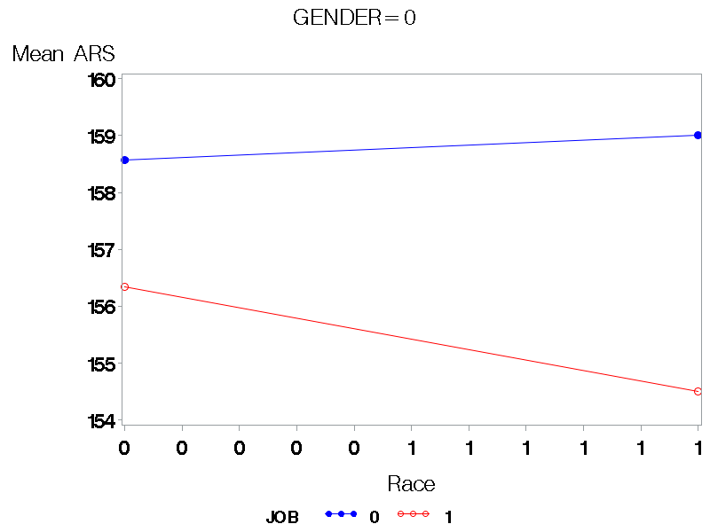
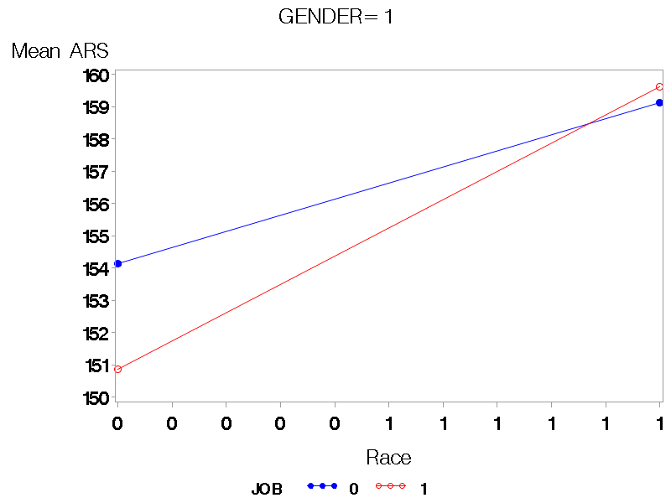
Month 3 3-way ANOVA – gender and race and job

Slide 9
Month 3 3-way ANOVA – gender and race and job
GENDER | RACE | JOB | ARS LSMEAN | 95% Confidence Limits
0 | 0 | 0 | 158.567521 | 152.840508 | 164.294534
0 | 0 | 1 | 156.342525 | 151.065411 | 161.619640
0 | 1 | 0 | 159.011177 | 152.859378 | 165.162976
0 | 1 | 1 | 154.495310 | 150.252754 | 158.737865
1 | 0 | 0 | 154.134238 | 144.816512 | 163.451965
1 | 0 | 1 | 150.866667 | 140.947189 | 160.786144
1 | 1 | 0 | 159.116059 | 150.302372 | 167.929747
1 | 1 | 1 | 159.609810 | 151.599110 | 167.620511
Source | DF | Sum of Squares | Mean Square | F Value | Pr > F
Model | 7 | 1692.0303 | 241.7186 | 0.63 | 0.7272
Error | 285 | 108572.8316 | 380.9573
Corrected Total | 292 | 110264.8618
Based on the available data, there is no evidence to indicate that at least one of the terms in the model is significantly useful in determining the Addiction Recovery Score of cocaine dependent patients.
No significant difference was found between any of the LSMean estimates
Source | DF | Type III SS | Mean Square | F Value | Pr > F
GENDER | 1 | 73.1843810 | 73.1843810 | 0.19 | 0.6615
RACE | 1 | 505.1704113 | 505.1704113 | 1.33 | 0.2505
GENDER*RACE | 1 | 761.5714577 | 761.5714577 | 2.00 | 0.1585
JOB | 1 | 301.2355282 | 301.2355282 | 0.79 | 0.3746
GENDER*JOB | 1 | 52.3662199 | 52.3662199 | 0.14 | 0.7111
RACE*JOB | 1 | 7.1948018 | 7.1948018 | 0.02 | 0.8908
GENDER*RACE*JOB | 1 | 121.8830076 | 121.8830076 | 0.32 | 0.5721
No evidence of a violation of homogeneity of variance, p=.9471
Evidence of violation of Independence
(1st order autocorrelation = 0.813; p-value <.0001)
Attempted to normalize the data, unfortunately, BoxCox was not able to yield normalized residuals, therefore the results should be interpreted with caution.
There is no evidence to indicate that the on average difference in Addiction Recovery Score between males and females varies differentially across the levels of race.

Slide 10
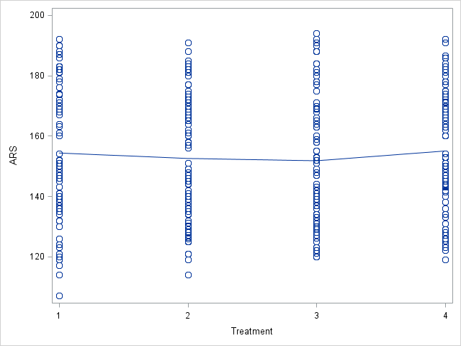
Month 6 One-Way ANOVA - treatment
Source | DF | Sum of Squares | Mean Square | F Value | Pr > F
Model | 3 | 576.9159 | 192.3053 | 0.44 | 0.7268
Error | 327 | 143948.0270 | 440.2080
Corrected Total | 330 | 144524.9430
Based on the available data, there is no evidence to indicate that at least one of the groups of treatment is significantly useful in determining the Addiction Recovery Score of cocaine dependent patients.
TX_COND | ARS LSMEAN | 95% Confidence Limits
1 | 154.284943 | 149.581216 | 158.988670
2 | 152.475646 | 148.024844 | 156.926447
3 | 151.713515 | 147.210039 | 156.216990
4 | 154.964591 | 150.461115 | 159.468067
No evidence of a violation of homogeneity of variance (p-value = 0.1690)
Independence assumption met (positive autocorrelation = 0.017, p-value = 0.3500)
Attempted to normalize the data, unfortunately, BoxCox was not able to yield normalized residuals, therefore the results should be interpreted with caution.
No significant difference was found between any of the LSMean estimates

Slide 11
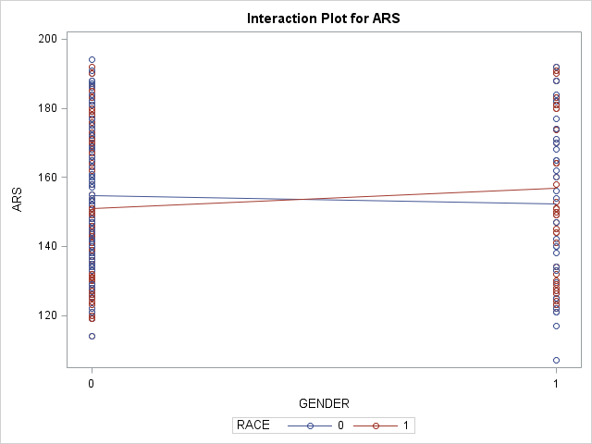
Month 6 2-Way ANOVA – gender and race
Source | DF | Sum of Squares | Mean Square | F Value | Pr > F
Model | 3 | 1600.2523 | 533.4174 | 1.22 | 0.3023
Error | 327 | 142924.6907 | 437.0786
Corrected Total | 330 | 144524.9430
Based on the available data, there is no evidence to indicate that at least one of the terms in the model is significantly useful in determining the Addiction Recovery Score of cocaine dependent patients.
Source | DF | Type III SS | Mean Square | F Value | Pr > F
GENDER | 1 | 167.510609 | 167.510609 | 0.38 | 0.5363
RACE | 1 | 14.257286 | 14.257286 | 0.03 | 0.8568
GENDER*RACE | 1 | 1102.810810 | 1102.810810 | 2.52 | 0.1132
Evidence of a violation of homogeneity of variance, p-value = .0144
Independence assumption met (positive autocorrelation = 0.012; p-value = 0.3822)
Attempted to normalize the data, unfortunately, BoxCox was not able to yield normalized residuals, therefore the results should be interpreted with caution.
There is no evidence to indicate that the on average difference in Addiction Recovery Score between males and females varies differentially across the levels of race.

Slide 12
Month 6 2-Way ANOVA – gender and race
Type 3 Tests of Fixed Effects
Effect | Num DF | Den DF | F Value | Pr > F
GENDER | 1 | 327 | 0.32 | 0.5750
RACE | 1 | 327 | 0.03 | 0.8700
GENDER*RACE | 1 | 327 | 2.07 | 0.1507
Least Squares Means
Effect | GENDER | RACE | Estimate | Standard Error | DF | t Value | Pr > |t|
GENDER*RACE | 0 | 0 | 154.83 | 1.8865 | 327 | 82.08 | <.0001
GENDER*RACE | 0 | 1 | 151.06 | 1.6936 | 327 | 89.20 | <.0001
GENDER*RACE | 1 | 0 | 152.24 | 4.1349 | 327 | 36.82 | <.0001
GENDER*RACE | 1 | 1 | 156.98 | 3.3734 | 327 | 46.53 | <.0001
None of the terms in the model is significantly useful in determining the Addiction Recovery Score of cocaine dependent patients.
Estimates
Label | Estimate | Standard Error | DF | t Value | Pr > |t| | Alpha | Lower | Upper
Male Non-Cau | 154.83 | 1.8865 | 327 | 82.08 | <.0001 | 0.05 | 151.12 | 158.55
Female Non-Cau | 152.24 | 4.1349 | 327 | 36.82 | <.0001 | 0.05 | 144.10 | 160.37
Difference A | 2.5964 | 4.5449 | 327 | 0.57 | 0.5682 | 0.05 | -6.3444 | 11.5373
Male Cau | 151.06 | 1.6936 | 327 | 89.20 | <.0001 | 0.05 | 147.73 | 154.40
Female Cau | 156.98 | 3.3734 | 327 | 46.53 | <.0001 | 0.05 | 150.34 | 163.61
Difference B | -5.9128 | 3.7746 | 327 | -1.57 | 0.1182 | 0.05 | -13.3383 | 1.5128
Difference A | 2.5964 | 4.5449 | 327 | 0.57 | 0.5682 | 0.05 | -6.3444 | 11.5373
Difference B | -5.9128 | 3.7746 | 327 | -1.57 | 0.1182 | 0.05 | -13.3383 | 1.5128
Overall Diff | 8.5092 | 5.9079 | 327 | 1.44 | 0.1507 | 0.05 | -3.1131 | 20.1315
The on-average difference between the difference of the means for males and females among Non-Caucasians compared to the difference of the means for males and females among Caucasians was 8.5092.
P-value = 0.1507, therefore, this difference is not significantly different from 0.

Slide 13
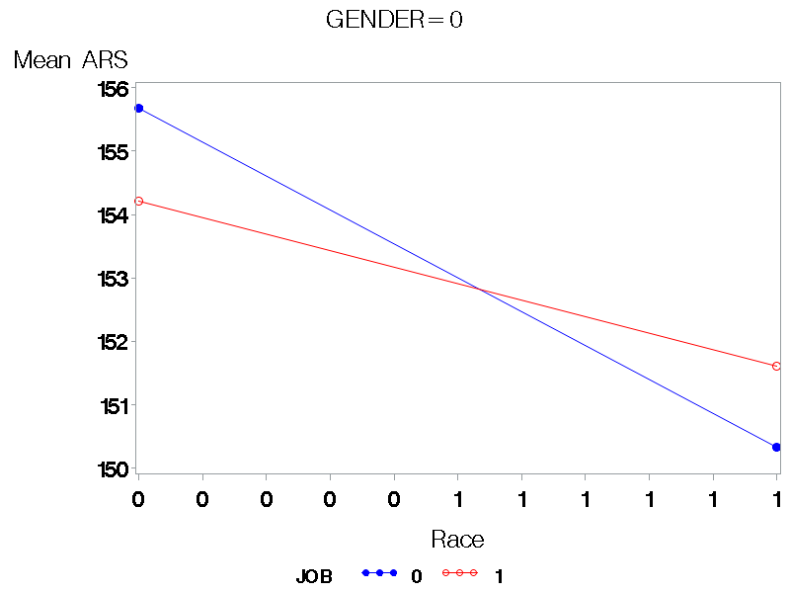
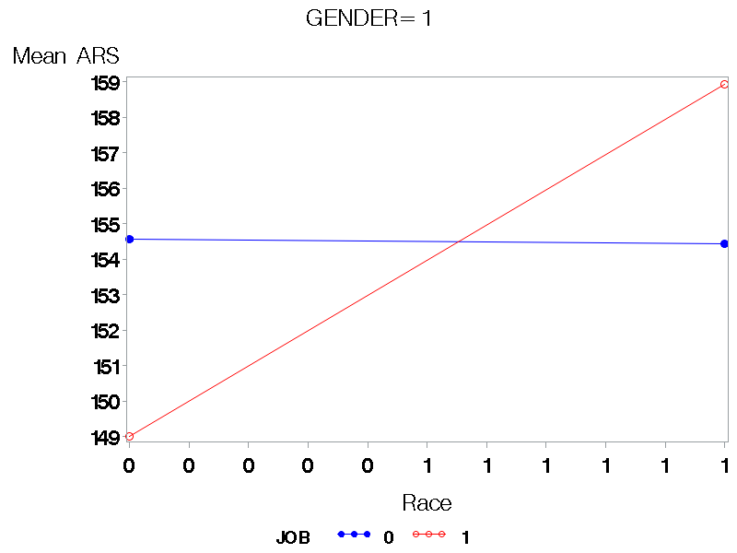
Month 6 3-Way ANOVA – gender, race and job

Slide 14
Month 6 3-Way ANOVA – gender, race and job
Heterogenous Model
Type 3 Tests of Fixed Effects
Effect | Num DF | Den DF | F Value | Pr > F
GENDER | 1 | 322 | 0.18 | 0.6733
RACE | 1 | 322 | 0.02 | 0.8773
GENDER*RACE | 1 | 322 | 2.18 | 0.1406
JOB | 1 | 322 | 0.01 | 0.9188
GENDER*JOB | 1 | 322 | 0.00 | 0.9439
RACE*JOB | 1 | 322 | 1.13 | 0.2877
GENDER*RACE*JOB | 1 | 322 | 0.37 | 0.5432
Source | DF | Sum of Squares | Mean Square | F Value | Pr > F
Model | 7 | 2151.0135 | 307.2876 | 0.70 | 0.6755
Error | 322 | 142167.8213 | 441.5150
Corrected Total | 329 | 144318.8348
Based on the available data, there is no evidence to indicate that at least one of the terms in the model is significantly useful in determining the Addiction Recovery Score of cocaine dependent patients.
There is no evidence to indicate that the on average difference in Addiction Recovery Score of the interaction between gender and race varies differentially across the levels of job.
evidence of a violation of homogeneity of variance, p=0202
Evidence of violation of Independence
(1st order autocorrelation = 0.912; p-value <.0001)
Attempted to normalize the data, unfortunately, BoxCox was not able to yield normalized residuals, therefore the results should be interpreted with caution.
Effect | GENDER | RACE | JOB | Estimate | Standard Error | t Value | Pr > |t| | Lower | Upper
GENDER*RACE*JOB | 0 | 0 | 0 | 155.68 | 3.1422 | 49.55 | <.0001 | 149.50 | 161.86
GENDER*RACE*JOB | 0 | 0 | 1 | 154.22 | 2.3389 | 65.93 | <.0001 | 149.61 | 158.82
GENDER*RACE*JOB | 0 | 1 | 0 | 150.33 | 3.1487 | 47.74 | <.0001 | 144.14 | 156.53
GENDER*RACE*JOB | 0 | 1 | 1 | 151.61 | 2.0057 | 75.59 | <.0001 | 147.66 | 155.56
GENDER*RACE*JOB | 1 | 0 | 0 | 154.55 | 5.5688 | 27.75 | <.0001 | 143.60 | 165.51
GENDER*RACE*JOB | 1 | 0 | 1 | 149.00 | 6.2671 | 23.78 | <.0001 | 136.67 | 161.33
GENDER*RACE*JOB | 1 | 1 | 0 | 154.43 | 4.7132 | 32.76 | <.0001 | 145.15 | 163.70
GENDER*RACE*JOB | 1 | 1 | 1 | 158.94 | 4.7852 | 33.21 | <.0001 | 149.52 | 168.35

Slide 15
Comparison Between Month 3 and Month 6 Results
Type of Analysis |  | Month 3 | Month 6
One-way ANOVA with Treatment | Sample Size | 294 | 331
 | Highest Mean | Treatment 1 | Treatment 4
 | Treatment Means | Higher | Lower
 | Significance | Not significant | Not significant
 | Treatment with Lowest Mean | Treatment 3 | Treatment 3
Two-way ANOVA with Gender and Race | Sample Size | 294 | 331
 | 2-way Interaction | Not significant | Not significant
 | Type of interaction | Disordinal | Disordinal
 | Highest Mean | Female Caucasians | Female Caucasians
 | Lowest Means | Female Non-Caucasians | Male Caucasians
 | Overall Significance | Not significant | Not significant
Three Way ANOVA With Gender, Race and Job | Sample Size | 293 | 330
 | 3-way Interaction | Not significant | Not significant
 | Highest Mean | Employed Female Caucasians | Employed Female Caucasians
 | Lowest Means | Employed Female Non-Caucasians | Employed Female Non-Caucasians
 | Overall Significance | Not significant | Not significant

Slide 16
Conclusion
No significant relationship found between treatment intervention and Addiction recovery Scores
No evidence to indicate an on average difference in Addiction Recovery Score between males and females across the 2 levels of race.
No evidence to indicate that the on average difference in Addiction Recovery Score of the interaction between gender and race varies differentially across the levels of job.

Slide 17
References
12 Step Programs: 12 Steps to Recovery from Addiction (Jul 10, 2023). American Addiction Centers. 12 Step AA Programs: 12 Steps to Recovery for Addiction (americanaddictioncenters.org)
Crits-Christoph, P., Siqueland, L., Blaine, J., Frank, A., Luborsky, L., Onken, L. S., ... & Beck, A. T. (1999). Psychosocial treatments for cocaine dependence: National Institute on Drug Abuse collaborative cocaine treatment study. Archives of general psychiatry, 56(6), 493-502.

